Slide 1
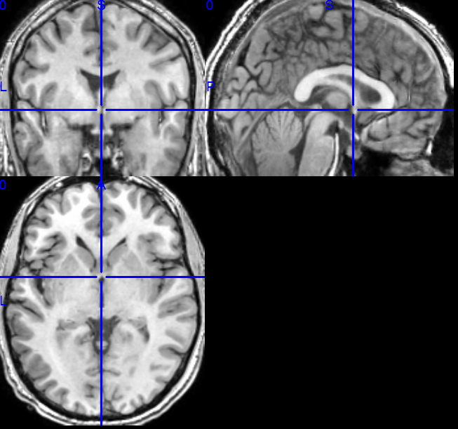
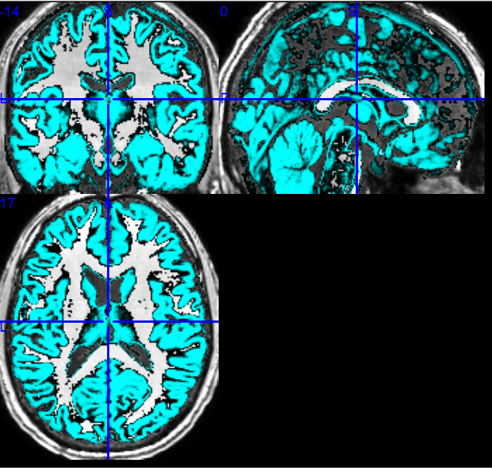
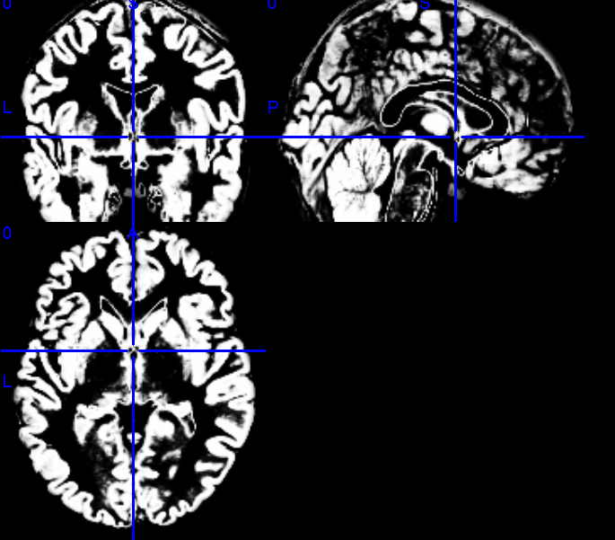
Using Contiguous Bi-Clustering for data driven temporal analysis of fMRI based functional connectivity

Slide 2
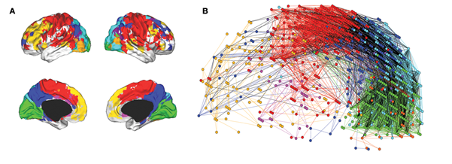
Background
The brain works in a hierarchical manner
Neurons-> (voxels->)regions->network-> function
Who plays
with whom
when ?
Notes:
Hierarchical modularity of a human brain functional network. (A) Cortical surface mapping of the community structure of the network at the highest hierarchical level of modularity, showing all modules that comprise more than 10 nodes. (B) Anatomical representation of the connectivity between nodes in colour-coded modules. The brain is viewed from the left side with the frontal cortex on the left of the panel and the occipital cortex on the right of the panel. Intra-modular edges are coloured differently for each module; inter-modular edges are drawn in black.
Hierarchical modularity in human brain functional networks
David Meunier^{1,2}, Renaud Lambiotte³, Alex Fornito^{1,2,4}, Karen D. Ersche^{1,2} and Edward T. Bullmore^{1,2,5}*

Slide 3
Existing methods
Data driven: PCA/ICA – requires large number of time points, performs a partition (finds disjoint components) over all time points, hierarchical clustering.
Hypothesis driven seed based/ generate network using anatomically defined regions. Problems: may not be accurate, can miss new information (e.g. sub-regional activity).

Slide 4
Advantages:
There may be a partial overlap between two networks.
Can reveal connections that appear in a subset of the TRs.
Disadvantages:
Bi-clustering methods tend to yield many results, from which it is hard to extract the biologically significant ones.

Slide 5
Suggested Model
Based on the prior knowledge that we have on the way that the brain works, we can assume:
A relatively low number of regions
A relatively low number of consecutive time point series.

Slide 6
Suggested method - heuristic
Perform analysis separately for each hemisphere
Use a sliding time window (currently 10 time pts).
For each window detect highly homogenous regions (neighboring voxel groups over size s) .
Merge regions/groups with high spatial overlap (time intervals either overlapping or disjoint).
Filter regions
Merge spatially disjoint regions/groups with highly similar signal (and high temporal overlap).

Slide 7
Identifying homogenous regions
Input: Graph G=(V,E) where V is the voxel set and E is the adjacency structure between them.
General goal: we want to find sets V’ ⊂ V and for each set an accompanying interval I= [i,j] such that G[V’] is connected and possibly of small diameter
The elements in V’ are similar when comparing their subvectors in the time interval I

Slide 8
Identifying homogenous regions
For a given time interval I:
Identify a set of seed nodes v*₁….v*_{n}
For each v* search for group U by scanning the neighbors of v* in BFS and add to U each vertex v that satisfies sim(v,v*)≥α or sim(v,sig_{U}) in interval I.
Stop when no vertex can be added to U or when the BFS depth is > d
Accept the set U if it is sufficiently large.
Addition: merge U₁ and U₂ if they overlap and signal is similar enough (sim(sig_{U1},sig_{U2}) ≥ α )

Slide 9
Selecting seed nodes
Seed nodes are selected using a variation of the “Furthest point” heuristic combined with the requirement of a seed to be “interesting” enough.
I.E. a list of “interesting” seed candidates is generated. At least k (=2) extreme values of mean±2stds.
At each step the candidate which is furthest from all previously selected seeds is chosen.

Slide 10
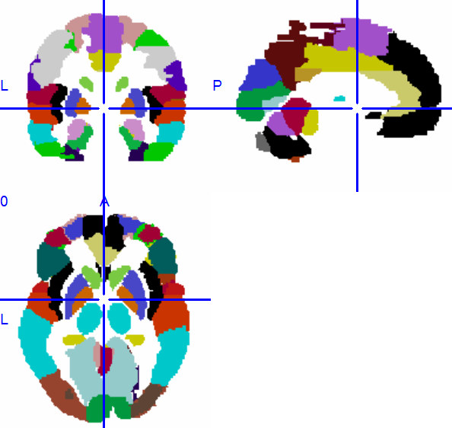
Evaluating regions
Size
Shape/clustering coefficient
Repetition (appearance in multiple time windows) OR TR span.
Homogeneity (mean pairwise similarity)
Anatomic mapping homogeneity the fraction of the region that is mapped(*) to the same anatomic label.
Tracing dynamics
Comparing with paradigm (if exists)
* Automated Anatomical Labeling (AAL) is a digital atlas of the human brain (partition). It is developed by a French research group based in Caen.

Slide 11
Validations
Comparing hemispheres
Analysis on scrambled data (circular shift maintains signal properties).
Signal dynamics analysis on moved groups

Slide 12
Data
4 foot motor datasets, 65 TRs (TR=2.5sec)
Right
10TR
Left
10TR
Right
10TR
Left
10TR
Rest
10TR
Rest
5TR
Rest
5TR
Rest
5TR
Rest
5TR
5 palm motor datasets 117TRs, 108TRs

Slide 13
Core regions
Subject | Correlation Thresh | #time windows | #groups (size>=10) | #group with area rep>=0.5 | Relevant motor areas
BEKI | 0.7 | 101 | 1231/1319 | 893/931 | +/+
BEKI | 0.8 | 101 | 472/393 | 351/306 | +/+
MAWE | 0.7 | 101 | 750/1189 | 479/549 | +/+
MAWE | 0.8 | 101 | 289/368 | 210/ | +/
OFPE | 0.7 | 92 | 1208/1384 | 767/885 | +/+
OFPE | 0.8 | 92 | 418/507 | 296/348 | +/+
SHEL | 0.7 | 92 | 848/785 | 635/519 | +/+
SHEL | 0.8 | 92 | 366/359 | 296/265 | +/+
SHRO | 0.7 | 92 | 801/1019 | 586/707 | +/+*
SHRO | 0.8 | 92 | 288/433 | 241/359 | +*/+
Notes:
In 0.8 the relevant motor areas appear in very few time intervals

Slide 14
Merging regions based on spatial overlap:
1) Find all group pairs with spatial jaccard above a threshold
2) Select the pair with the highest jac (greedy)
3) Extract the spatial intersection
4) Expand the group using BFS (under time intervals union)
5) Accept new group if it is large enough
6) Repeat steps 1-5 until no pairs are found

Slide 15
Intermediate Results:
Correlation threshold | Jaccard threshold | Initial #groups | Resulting #groups | % of input | %of groups with split times | Mean homogeneity
0.7 | 0.3 | 750-1400 | 240-600 | 30-50% | ~6-16% | 0.679
0.7 | 0.5 | 750-1400 | 400-800 | 47-66% | ~1-5% | 0.68
0.7 | 0.6 | 750-1400 | 500-900 | 57-75% | ~1-2% | 0.68
0.7 | 0.7 | 750-1400 | 570-1050 | 68-81% | ~0-0.6% | 0.684
0.8 | 0.3 | 280-510 | 111-178 | 30-45% | ~4-14% | 0.788
0.8 | 0.5 | 280-510 | 150-300 | 43-61% | ~1-4.4% | 0.788
0.8 | 0.6 | 280-510 | 177-350 | 52-72% | ~0-3% | 0.789
0.8 | 0.7 | 280-510 | 199-412 | 65-81% | ~0-1% | 0.79
* Cases in which one group contains another are missed.

Slide 16
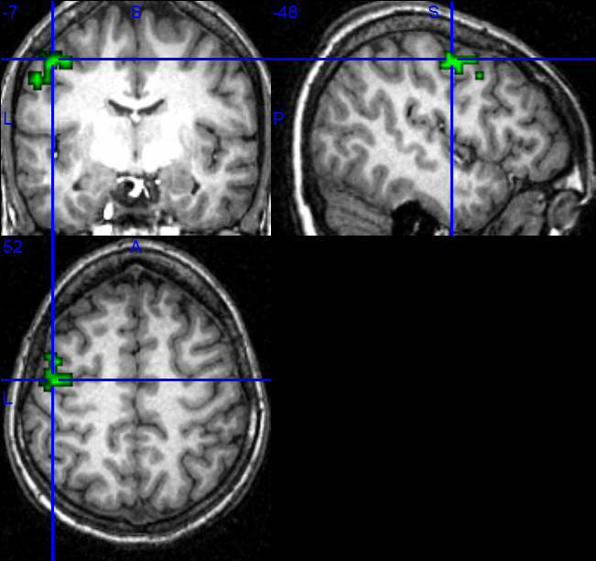
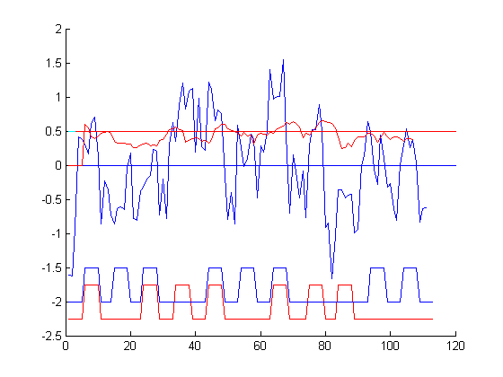
Intermediate Results – tracing group dynamics
Signal
Correlation
Right hand
Left hand
Subject = BEKI ; Hemisphere = Left; Homogeneity = 0.706; size = 61 voxels; time intervals=42:51,84:97,105:114; area=motor; spatial center=(9,36,32)

Slide 17
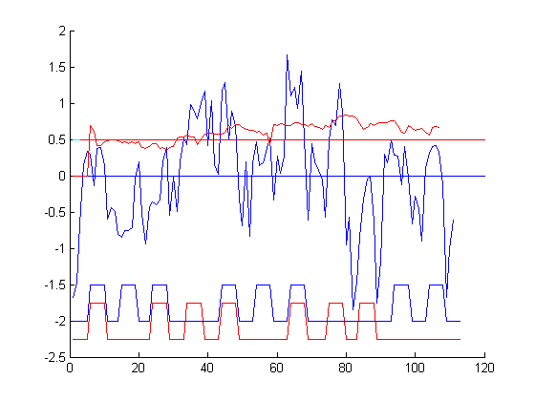
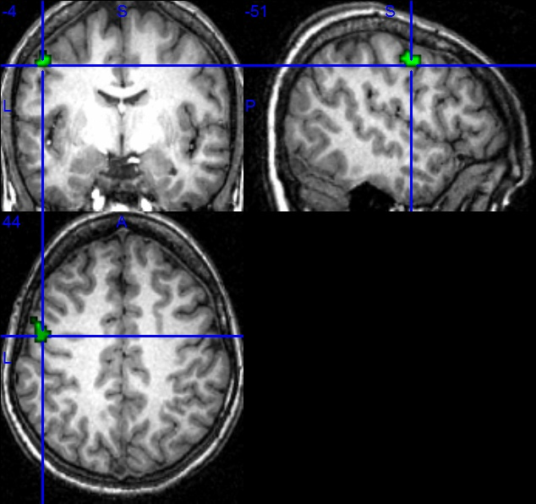
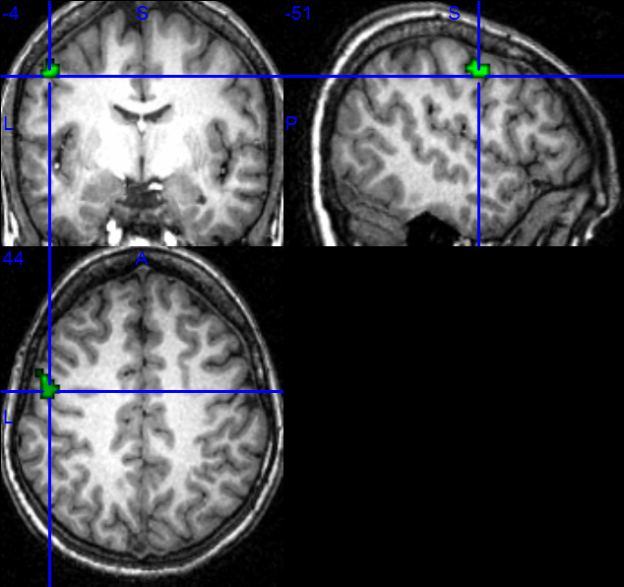
Intermediate Results – tracing group dynamics
Signal
Correlation
Right hand
Left hand
Subject = BEKI ; Hemisphere = Left; Homogeneity = 0.737; size = 18 voxels; time intervals=84:97,105:114; area=motor; spatial center=(8,36,32)

Slide 18
Intermediate Results – tracing group dynamics
Signal
Correlation
Right hand
Left hand
Subject = SHEL ; Hemisphere = Left; Homogeneity = 0.737; size = 18 voxels; time intervals=84:97,105:114; area=motor; spatial center=(8,36,32)

Slide 19
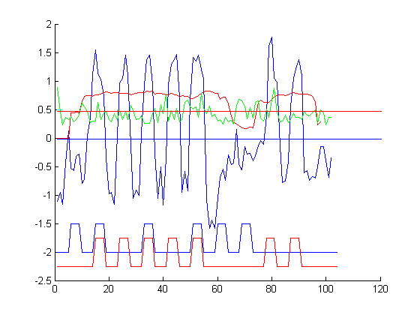
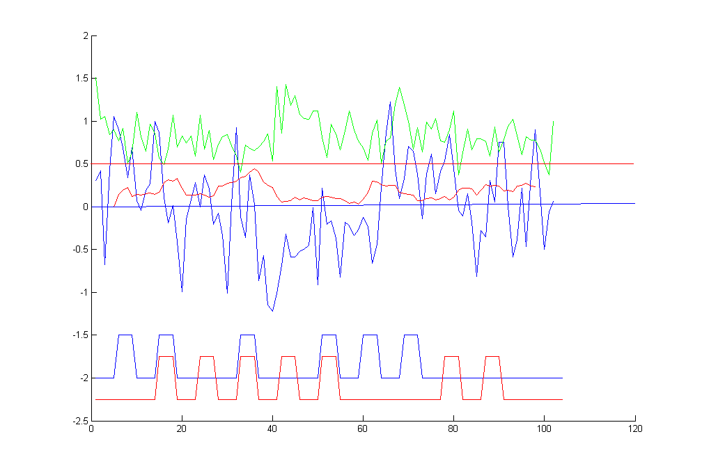
Comparing group dynamics to moved group dynamics
Real group
Moved group

Slide 20
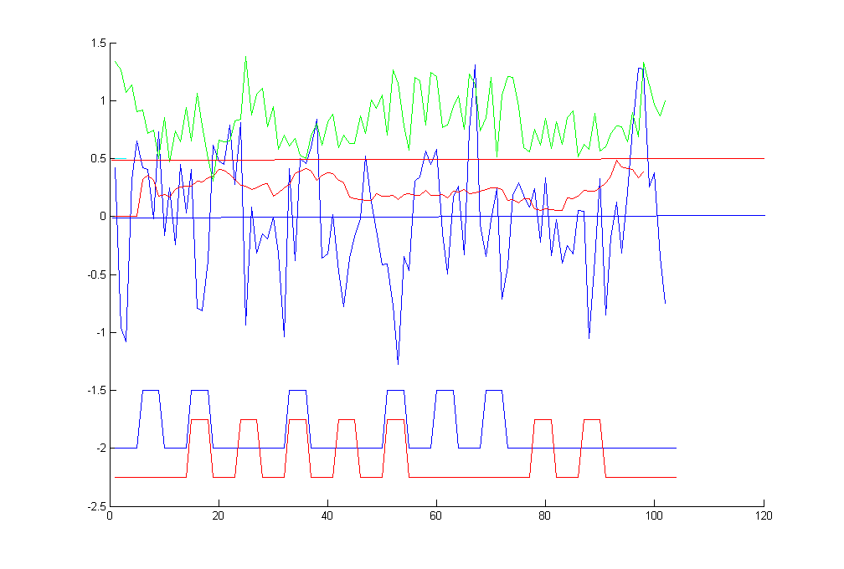
Comparing group dynamics to moved group dynamics
Real group
Moved group

Slide 21
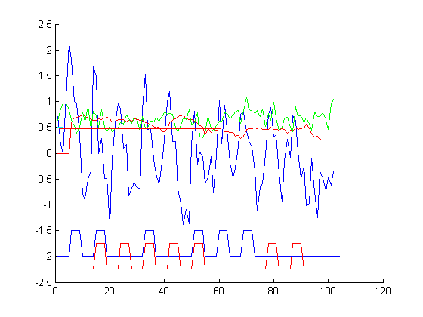
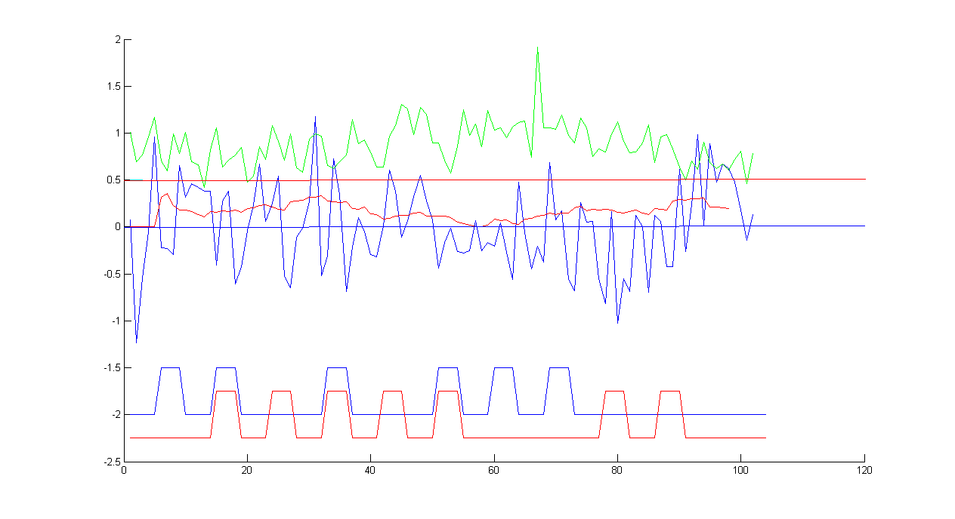
Comparing group dynamics to moved group dynamics
Real group
Moved group

Slide 22
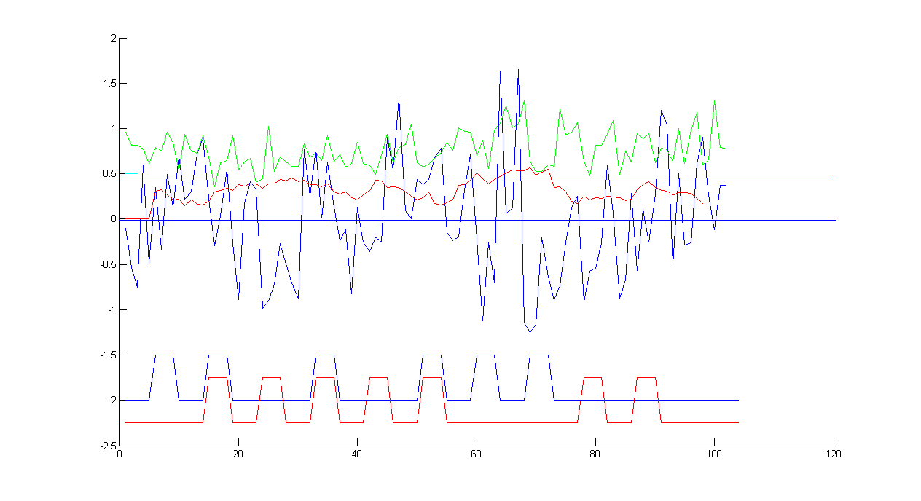
Comparing group dynamics to moved group dynamics
Real group
Moved group

Slide 23
Defining region groups based on signal similarity
1) Find all group pairs with TR jaccard>thresh
2) Select the pair (g1,g2) with the highest signal correlation under TR intersection (#TRs>thresh, cor>thresh)
3) Extract a group that is composed of (g1Ug2) voxels under the intersection of time points
4) Expand new group time intervals while maintaining homogeneity above a threshold
5) Accept new group if it is large enough
6) Repeat steps 1-5 until no group pairs are found

Slide 24
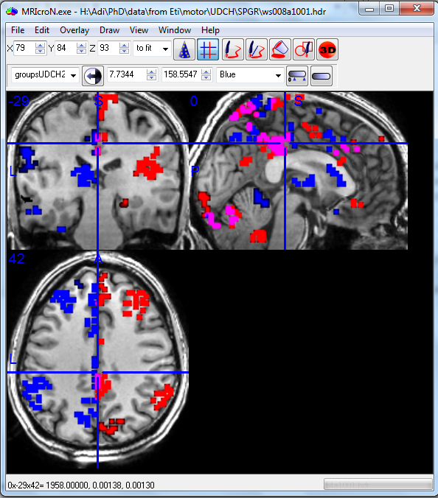
Visualizations

Slide 25
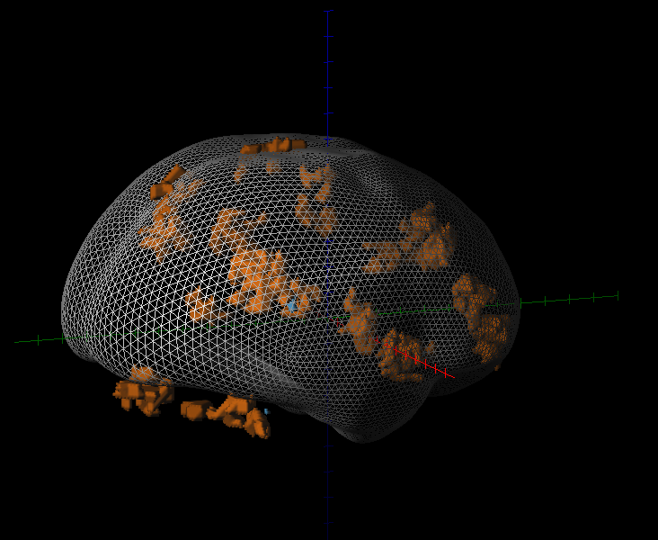
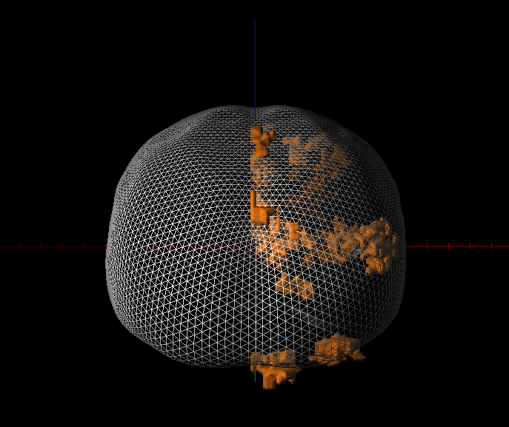
Visualization – 3D

Slide 26
Open issues:
How to merge separate regions
Jaccard threshold
When and how to filter regions
Problem with our initial assumption

